Slide 1
KORUS-AQ Timeline of Significant Events and Future Milestones
May 2010 | NCAR scientists visit several sites and institutions and begin thinking about the possibility of an aircraft experiment
2011 | NCAR-NIER collaborative observation at Taehwa Research Forest initiated
September 2012 | NASA & NCAR visit to Korea and discussion of common interests and respective capabilities with scientists at NIER
September 2013 | Korean visitors including an official from the Ministry of Environment visit Houston for DISCOVER-AQ to see a field study in action and discuss common interests for a study in Korea
December 2013 | Town Hall at Fall AGU meeting to gauge community interest in an air quality study working with Korea
January 2014 | A preliminary rationale document is completed to articulate the merits of an air quality study in Korea with details on how the US and Korea might cooperate
May 2014 | Second visit to Korea, Steering Group is formed; KORUS-AQ name is adopted; visit to Osan airbase

Slide 2
KORUS-AQ Timeline of Significant Events and Future Milestones
November 2014 | Initial draft of International Agreement finalized by NASA and transmitted to State Department
December 2014 | US and Korean White Papers completed by the KORUS-AQ Steering Group and made available online
January 2015 | Biweekly webex discussions between US and Korean Steering Group members begin
February 2015 | KORUS-AQ Solicitation for proposals issued in ROSES 2015
April 2015 | NASA sends scientists to Korea for early installation of Pandora spectrometers and Aeronet sunphotometers at 6 field sites to collect observations in advance of the 2016 field study
May 2015 | International Agreement returned from State Department with minimal comment and forwarded to Korea
May 2015 | KORUS-AQ due date for proposals on 15th (66 proposals submitted)
May/June 2015 | Korean colleagues conduct a pre-campaign of ground observations and King Air research flights

Slide 3
KORUS-AQ Timeline of Significant Events and Future Milestones
June 2015 | Third visit to Korea; Steering Group finalizes deployment dates (1 May – 15 June 2016); meetings at Osan airbase demonstrate basic feasibility and the decision to base the research aircraft there is finalized
July 2015 | KORUS-AQ Panel Review convenes; Korean scientists participate as both reviewers and observers
August 2015 | KORUS-AQ Science Team selections announced (23 proposals selected)
September 2015 | Korea accepts final language of the International Agreement (MOU)
October 2015 | KORUS-AQ Science Team meeting at NASA LaRC, signed MOU delivered

Slide 4
KORUS-AQ Timeline of Significant Events and Future Milestones
December 2015 | Convene AGU sessions and meet to discuss progress in field study plans
January 2016 | Visit Air Traffic Control authorities in Korea to discuss flight plans
March-April 2016 | Aircraft integration (DC-8 and LaRC King Air)
May-June 2016 | KORUS-AQ Field Deployment (120 research flight hours for each aircraft)

Slide 5
Scientific rationale and the unique value of a Korean study
Satellite observability of air quality
Including integration with models and ground monitoring networks
Validation strategy testbed with benefits to GEO (TEMPO, GEMS, Sentinel-4) and LEO (Sentinel-5 precursor) missions

Slide 6
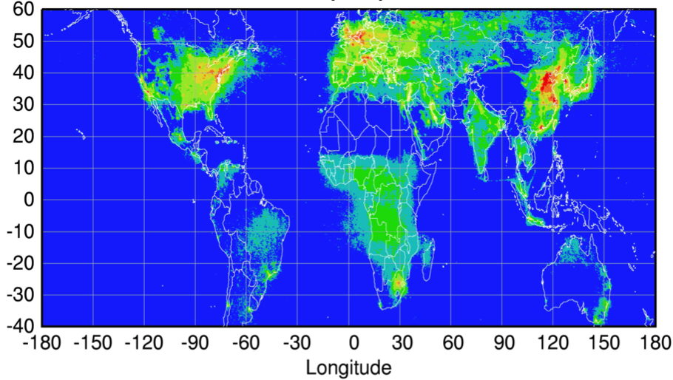
Global Pollution Monitoring Constellation (2018-2020)
Sentinel-4
(hourly)
TEMPO
(hourly)
GEMS
(hourly)
Sentinel-5P
(once per day)
Courtesy Jhoon Kim,
Andreas Richter
Policy-relevant science and environmental services enabled by common observations
Improved emissions, at common confidence levels, over industrialized Northern Hemisphere
Improved air quality forecasts and assimilation systems
Improved assessment, e.g., observations to support United Nations Convention on Long Range Transboundary Air Pollution

Slide 7
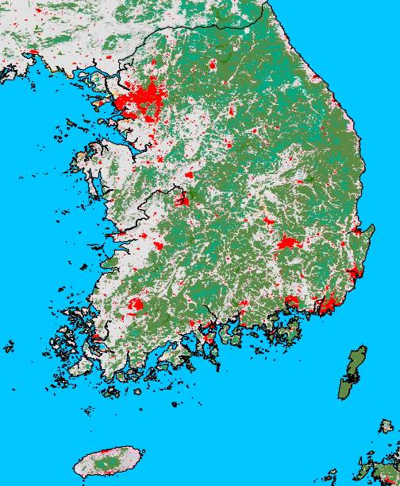
Scientific rationale and the unique value of a Korean study
Satellite observability of air quality
Including integration with models and ground monitoring networks
Validation strategy testbed with benefits to GEO (TEMPO, GEMS, Sentinel-4) and LEO (Sentinel-5 precursor) missions
Megacity environment – Model evaluation of Emissions, Chemistry, Transport
Seoul Metropolitan Area (SMA) ranked as 2nd largest metropolitan area worldwide
SMA includes approx. 50% of Korean population
MODIS land cover map of South Korea.
Red colors denote urban and built-up areas, greens are forests, and gray indicates croplands (courtesy Christine Wiedinmyer).

Slide 8
Scientific rationale and the unique value of a Korean study
Satellite observability of air quality
Including integration with models and ground monitoring networks
Validation strategy testbed with benefits to GEO (TEMPO, GEMS, Sentinel-4) and LEO (Sentinel-5 precursor) missions
Megacity environment – Model evaluation of Emissions, Chemistry, Transport
Seoul Metropolitan Area (SMA) ranked as 2nd largest metropolitan area worldwide
SMA includes approx. 50% of Korean population
Anthropogenic/Biogenic Mixtures
Sharp transition between SMA and surrounding rural areas provides opportunities to target specific urban/rural mixtures and discern impacts on secondary pollution formation (ozone and aerosols)

Slide 9
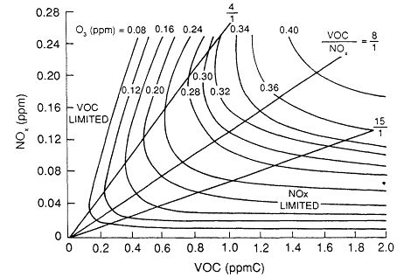
This typical ozone isopleth diagram shows the nonlinear response of ozone production to mixtures of NO_{x} and hydrocarbons. The diversity of mixtures occurring across the Seoul Metropolitan Area (NOx and VOC sources) and downwind (BVOC sources) provide an ideal natural laboratory to examine a broad range of mixtures.

Slide 10
Scientific rationale and the unique value of a Korean study
Satellite observability of air quality
Including integration with models and ground monitoring networks
Validation strategy testbed with benefits to GEO (TEMPO, GEMS, Sentinel-4) and LEO (Sentinel-5 precursor) missions
Megacity environment – Model evaluation of Emissions, Chemistry, Transport
Seoul Metropolitan Area (SMA) ranked as 2nd largest metropolitan area worldwide
SMA includes approx. 50% of Korean population
Anthropogenic/Biogenic Mixtures
Sharp transition between SMA and surrounding rural areas provides opportunities to target specific urban/rural mixtures and discern impacts on secondary pollution formation (ozone and aerosols)
Transboundary pollution – Local sources versus upwind along the Pacific Rim
Evaluate transport efficiency, removal rates, deposition impacts
Surrounding waters serve as a buffer to isolate upwind from local sources
Numerous upwind megacities, e.g., Beijing and Shanghai
Opportunity to confirm Asian emission trends via comparison with previous airborne campaigns

Slide 11
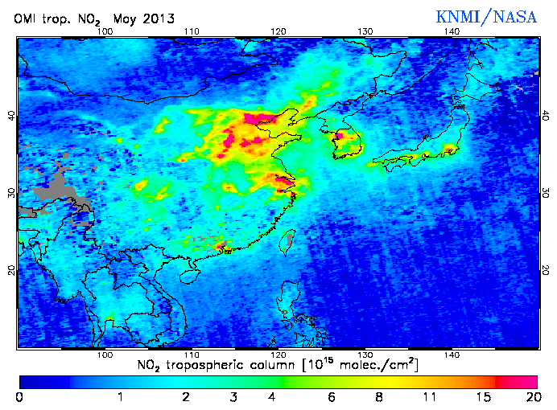
Example of the distribution of tropospheric NO₂ over Asia.
(http://www.temis.nl/airpollution/no2.html)
Mean annual tropospheric NO₂ column densities detected by the GOME and SCIAMACHY satellites show large relative changes in NO2 over China from 1996-2011.
(taken from Hillbol et al., 2013)

Slide 12
Scientific rationale and the unique value of a Korean study
Satellite observability of air quality
Including integration with models and ground monitoring networks
Validation strategy testbed with benefits to GEO (TEMPO, GEMS, Sentinel-4) and LEO (Sentinel-5 precursor) missions
Megacity environment – Model evaluation of Emissions, Chemistry, Transport
Seoul Metropolitan Area (SMA) ranked as 2nd largest metropolitan area worldwide
SMA includes approx. 50% of Korean population
Anthropogenic/Biogenic Mixtures
Sharp transition between SMA and surrounding rural areas provides opportunities to target specific urban/rural mixtures and discern impacts on secondary pollution formation (ozone and aerosols)
Transboundary pollution – Local sources versus upwind along the Pacific Rim
Evaluate transport efficiency, removal rates, deposition impacts
Surrounding waters serve as a buffer to isolate upwind from local sources
Numerous upwind megacities, e.g., Beijing and Shanghai
Opportunity to confirm Asian emission trends via comparison with previous airborne campaigns

Slide 13
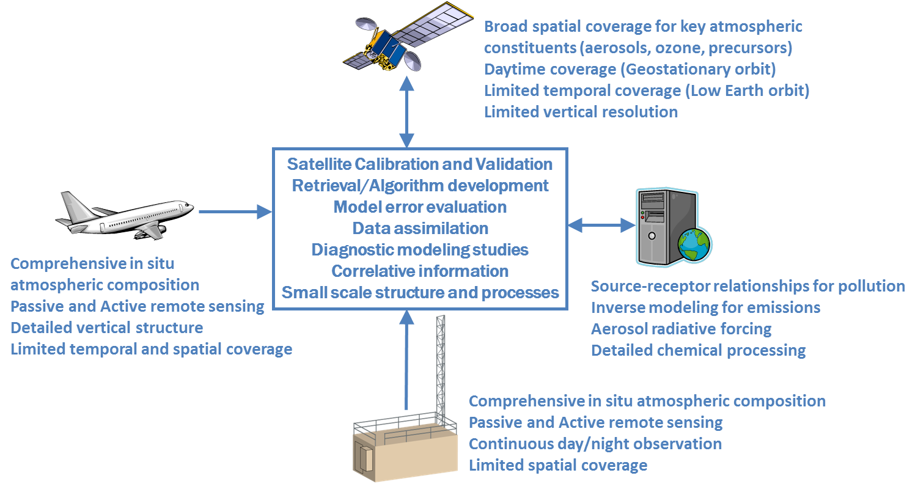
NASA’s Atmospheric Composition Goals emphasize “Progress in understanding and improving predictive capability for changes in the ozone layer, climate forcing, and air quality associated with changes in atmospheric composition.”

Slide 14
KORUS-AQ will combine assets from the Korean and U.S. atmospheric scientists communities and their supporting organizations (NIER, NASA, Universities, etc.) to implement an integrated observing system for improving our understanding of Air Quality
GOCI, OMI, MODIS, CALIPSO, IASI, etc.
Model evaluation and improvement, chemical process understanding, GEMS validation and observing strategies
NASA DC-8
NASA King Air
Hanseo King Air
KMA King Air
Operational Air Quality Forecasts, Regional and Global models of atmospheric composition
Air Quality Network, Research Sites, Research Vessels including in situ and remote sensing observations (lidar, Aeronet, Pandora)

